Slide 1
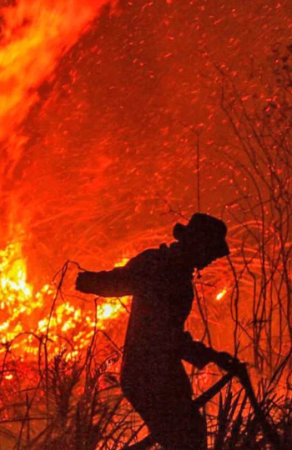
PREDICTING HOTSPOT INTENSITIES
Group ID: 3
Say Yueyang, Symus | He Zeqing | Kwek Yan Qing

Slide 2
TABLE OF CONTENTS
1
INTRODUCTION
2
MOTIVATION
3
PROPOSED SOLUTION
4
ANALYSIS
5
CONCLUSION

Slide 3
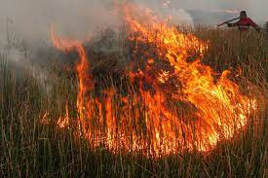
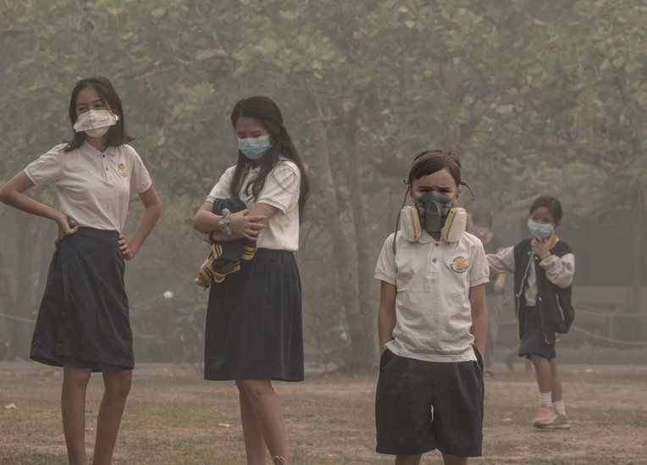
INTRODUCTION
Indonesia’s Forest Fires
Haze Problem
Notes:
Haze is one major form of air pollution that Singaporeans face annually. The presence of haze is attributed to the forest fires in Sumatra, Indonesia. Due to the increase in demand of commercial crops, Indonesian farmers have resorted to shifting agriculture, which includes the large-scale slash-and-burn of forest land to produce fertile planting grounds. The resulting air pollution is then spread across the region by the climatic phenomenon El Nino, enveloping Singapore in a blanket of haze and affecting the overall health of Singaporeans. In 2020, Indonesia fires torched approximately 207,000 hectares of forests from January to September. While the area is smaller compared to previous years, the burning resulted in a US$5.2 billion cost towards the Indonesian economy, and the occurrence of toxic smog over the city.

Slide 4
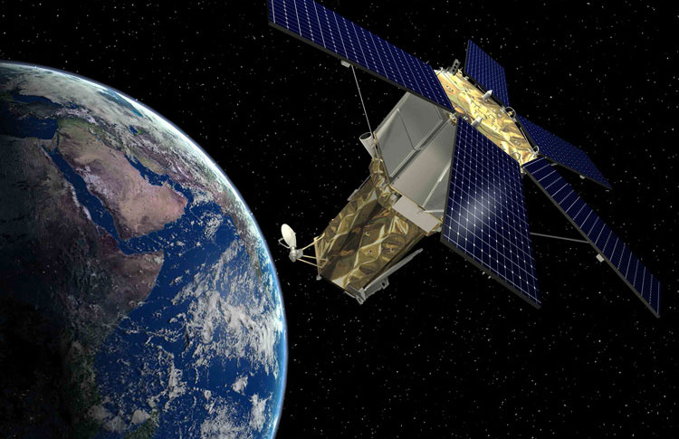
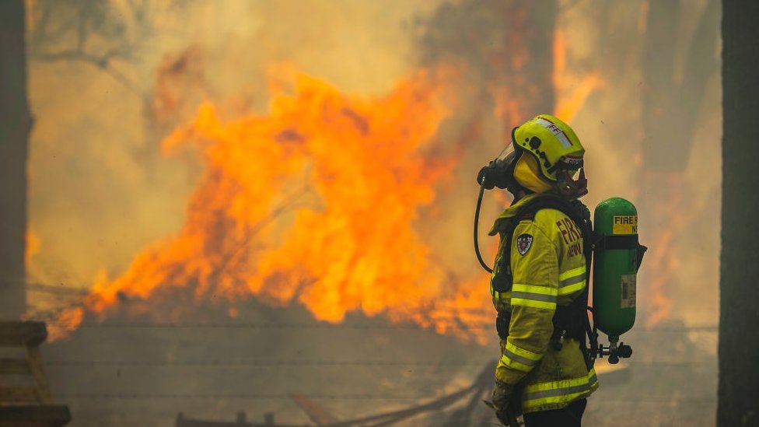
MOTIVATION
Brightness
data
Prevent fires from escalating
Deploy firefighting teams
Can we predict how intense a fire will be based on where it starts and how bright the fire burns?
Notes:
We want to see are able to predict how intense a fire will be based on location and brightness data captured by the satellite imaging. If there is a relation, we can utilize more satellites to detect fires and locate firefighters and agencies against slash and burn near places which tends to produce the worst fires.

Slide 5
PROPOSED SOLUTION
Data Acquisition and Visualization
Pre-processing
Generate Predictive Models
Compare Accuracy of Models
To predict Fire Radiative Power (FRP) from location and brightness data.
Notes:
We want to see are able to predict how intense a fire will be based on location and brightness data captured by the satellite imaging. If there is a relation, we can utilize more satellites to detect fires and locate firefighters and agencies against slash and burn near places which tends to produce the worst fires.

Slide 6

PROPOSED SOLUTION
Data Acquisition
NOAA-20 Satellite
VIIRS
Data extracted from NASA’s Fire Information for Resource Management System (FIRMS).
Dynamic data; near real-time (3h delay)
Dataset available: 24h/48h/7 days

Slide 7
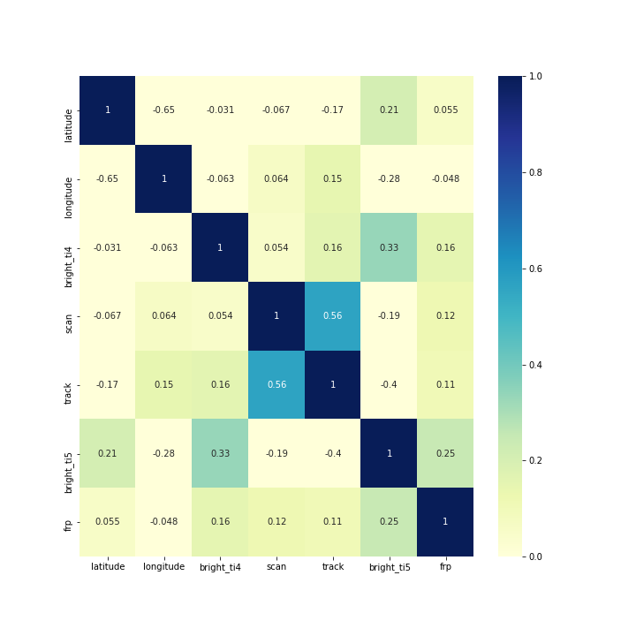
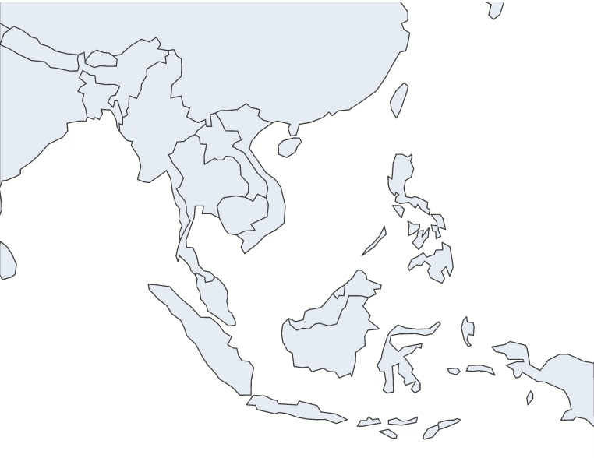
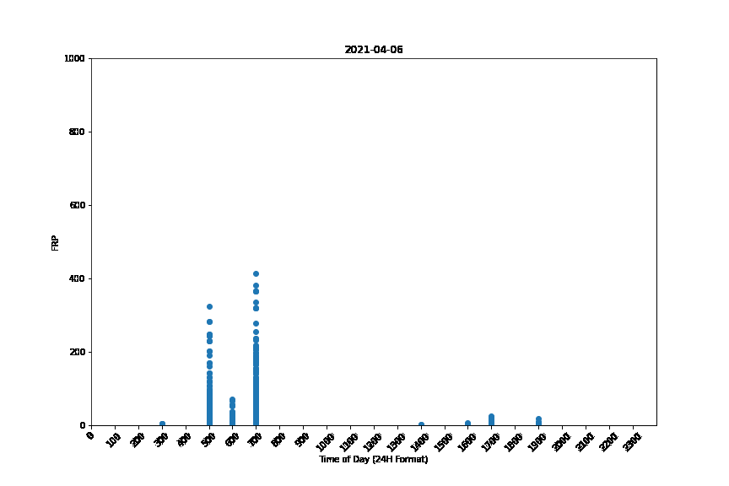
PROPOSED SOLUTION
Data Visualization
Seaborn
Covariance Matrix, Scatter Plot
Plotly
Time-Series
Matplotlib
Time-Series (Hourly)

Slide 8
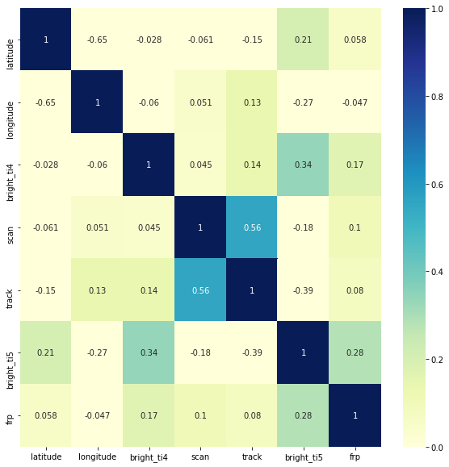
PROPOSED SOLUTION
Data Visualization
Correlation Matrix
Observed correlation between Brightness and FRP
Observed correlation between scan and track (related to satellite movement)

Slide 9
PROPOSED SOLUTION
Data Visualization
Time-Series Plot
Plot of FRP values for every satellite recording
Observed repeated/segmented data

Slide 10
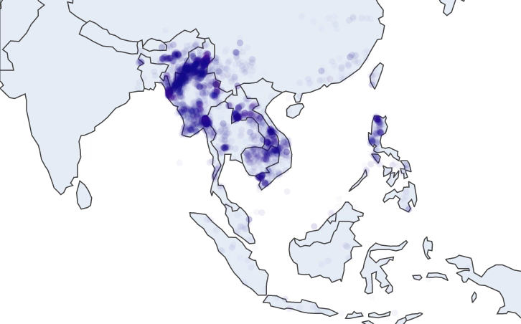
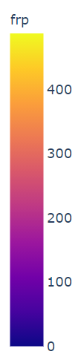
PROPOSED SOLUTION
Data Visualization
Time-Series Plot
Plot of FRP values animated over every day
Observed concentration of fire data in same region

Slide 11
PROPOSED SOLUTION
Data Visualization
Time-Series Plot
Plot of FRP values for every hour, animated over every day
Observed peaks at certain times of day

Slide 12
PROPOSED SOLUTION
Pre-Processing
Reformatting Features
Reverse Geocoding with GeoPandas
Binned Dataset
One Hot Encoding
Binning Continuous Variables
One Hot Encoding
Mixed Dataset

